Slide 1

DATA STRUCTURES AND ALGORITHMS (113215)
Dr. Owais Hussain

Slide 2

Agenda
Queue
Memory representation
Queue Operations
Array Implementation
Linked List Implementation
Complexity Analysis
In real life

Slide 3

Sample 2
Queue
An Abstract Data Type which works on the principles of FIFO (First-In-First-Out) (پہلے آئیے۔ پہلے پائیے)
A queue can be constructed using an Array or a Linked List.
A queue allows only 5 operations:
Enqueue: another name for Insert at the beginning of the list.
Dequeue: fetches the least recent element and removes from the list.
Peek: fetches the top element but does not remove it.
Is Empty: checks if the Queue has any elements.
Destroy or Clear: removes the elements and frees up the memory.

Slide 4
Sample 2
Memory representation – In Linked List
After Enqueuing first element
TAIL
3080
Hafs
HEAD
3080
Previous: Null
After Enqueuing two more elements
TAIL
3240
Mohimin
Asra
Hafs
HEAD
3080
Previous: Null
Previous: 3240
Previous: 3160
After Enqueuing all 5 elements
TAIL
3480
Omar Baig
Shahzaman
Mohimin
Asra
Hafs
HEAD
3080
Previous: Null
Previous: 3400
Previous: 3320
Previous: 3240
Previous: 3160
After Dequeuing first element
TAIL
3480
Omar Baig
Shahzaman
Mohimin
Asra
HEAD
3160
Previous: Null
Previous: 3400
Previous: 3320
Previous: 3240
Notes:
The representation in Arrays is same. Except that instead of pointers, we store indices in head and tail.

Slide 5
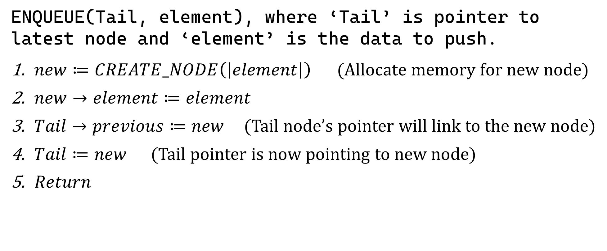
Sample 2
Queue Operations
ENQUEUE(Tail, element), where ‘Tail’ is pointer to latest node and ‘element’ is the data to push.
$new≔CREATE_NODE\left(\left|element\right|\right)$ $\text{(}\text{Allocate} \text{memory} \text{for} \text{new} \text{node}\text{)}$
$new→element≔element$
$Tail→previous≔new$ (Tail node’s pointer will link to the new node)
$Tail≔new$ (Tail pointer is now pointing to new node)
$Return$

Slide 6
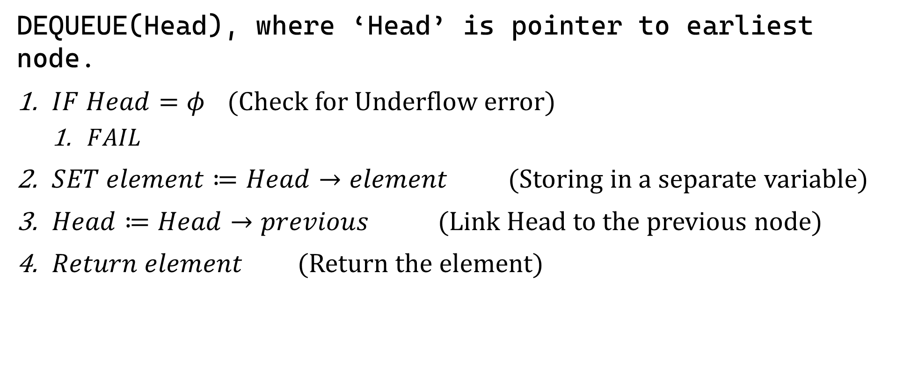
Sample 2
Queue Operations
DEQUEUE(Head), where ‘Head’ is pointer to earliest node.
$IF Head=φ$ (Check for Underflow error)
$FAIL$
$SET element≔Head→element$ (Storing in a separate variable)
$Head≔Head→previous$ (Link Head to the previous node)
$Return element$ (Return the element)

Slide 7

Sample 2
Queue Operations
PEEK(Head)
$IF Head=φ$, then
$FAIL$
$Return Head→element$
IS_EMPTY(Head)
$IF Head=φ$, then $Return$ $true$
$Return$ $false$
CLEAR(Head)
$REPEAT while Head≠φ$ $DEQUEUE$ $\left(Head\right)$ $Head≔φ$, $Tail≔φ$
$Return$

Slide 8
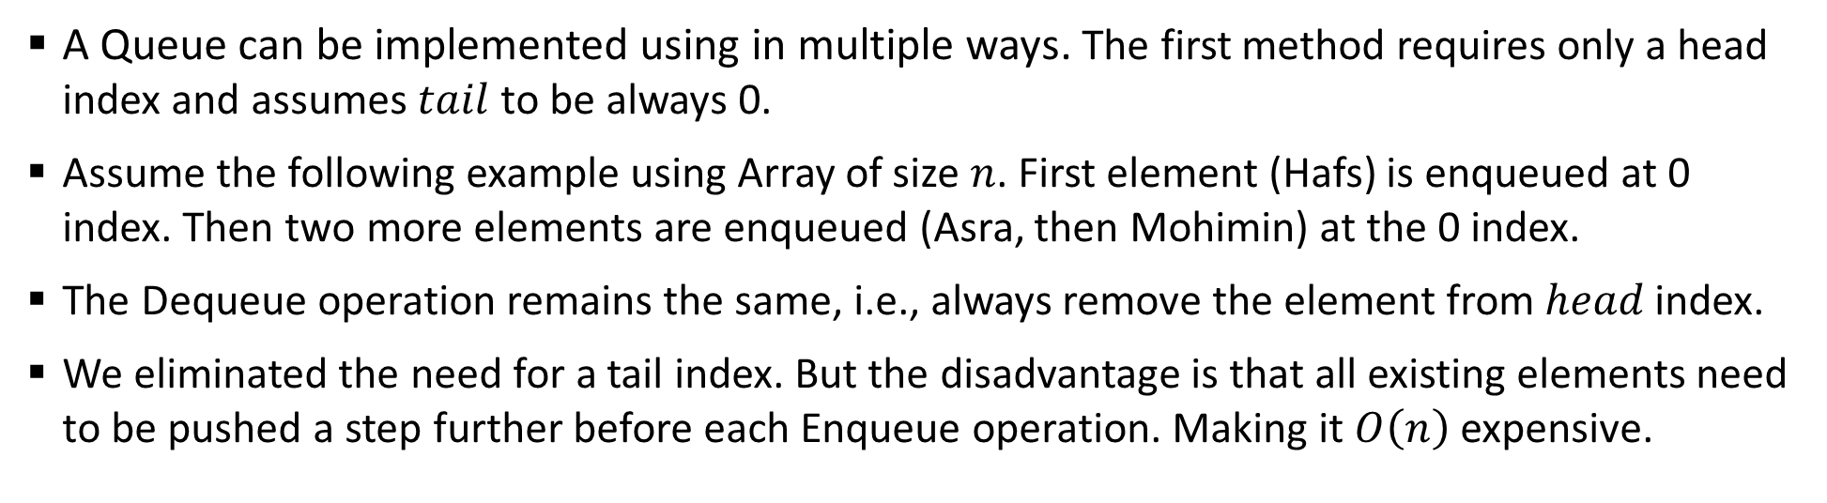
Sample 2
Array Implementation
A Queue can be implemented using in multiple ways. The first method requires only a head index and assumes $tail$ to be always 0.
Assume the following example using Array of size $n$. First element (Hafs) is enqueued at 0 index. Then two more elements are enqueued (Asra, then Mohimin) at the 0 index.
The Dequeue operation remains the same, i.e., always remove the element from $head$ index.
We eliminated the need for a tail index. But the disadvantage is that all existing elements need to be pushed a step further before each Enqueue operation. Making it $O\left(n\right)$ expensive.
Hafs
0
Head
Mohimin
Asra
Hafs
0
1
2
Head

Slide 9
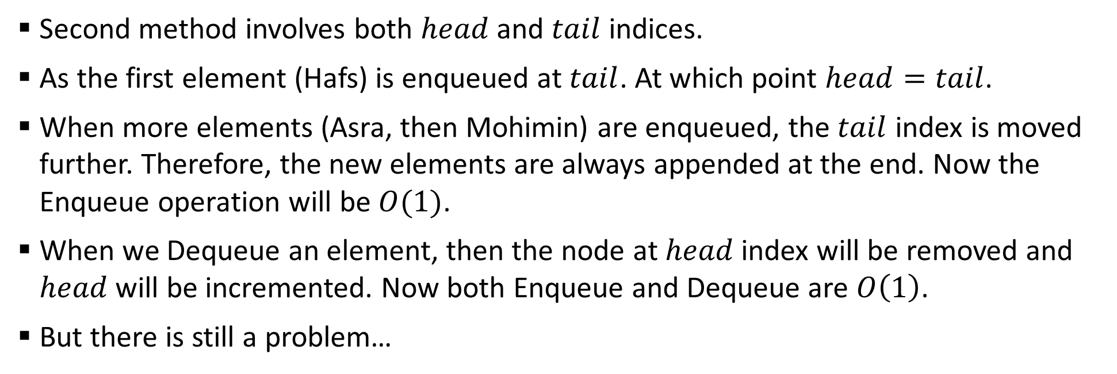
Sample 2
Array Implementation
Second method involves both $head$ and $tail$ indices.
As the first element (Hafs) is enqueued at $tail$. At which point $head=tail$.
When more elements (Asra, then Mohimin) are enqueued, the $tail$ index is moved further. Therefore, the new elements are always appended at the end. Now the Enqueue operation will be $O(1)$.
When we Dequeue an element, then the node at $head$ index will be removed and $head$ will be incremented. Now both Enqueue and Dequeue are $O\left(1\right)$.
But there is still a problem…
Hafs
Asra
Mohimin
Head
0
1
2
Tail

Slide 10
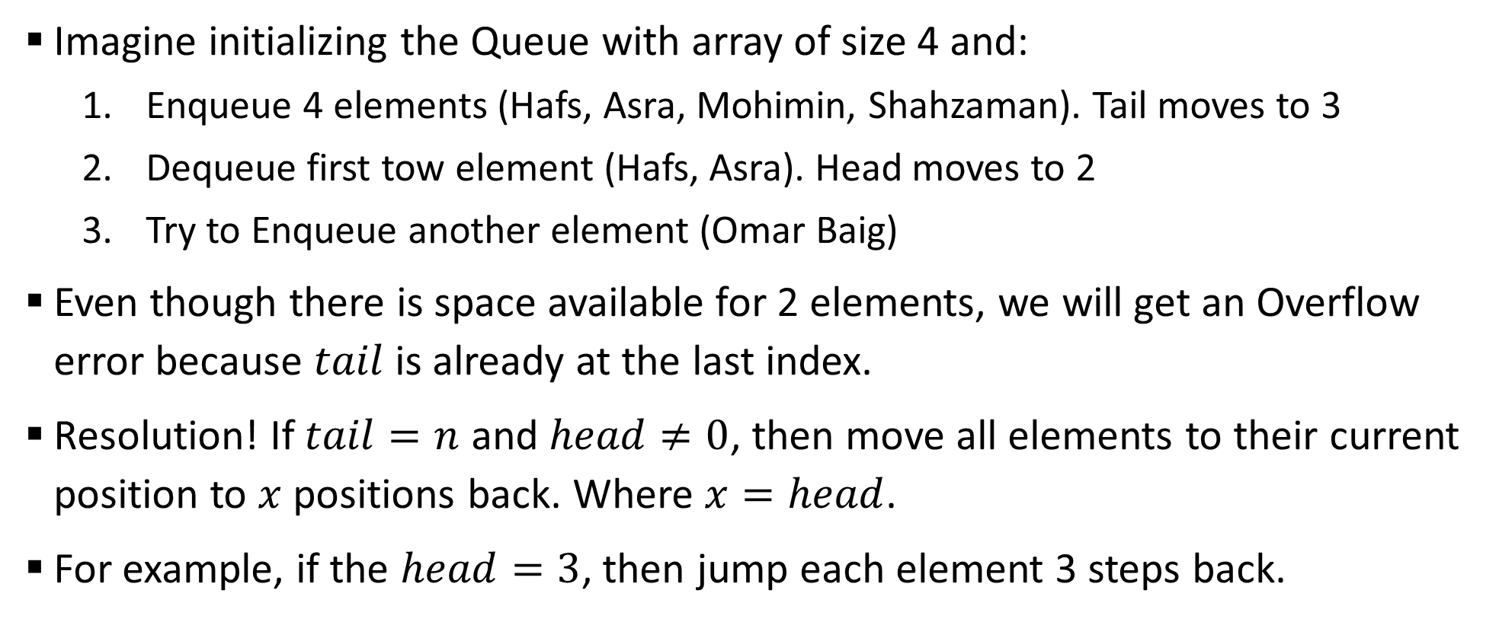
Sample 2
Array Implementation
Imagine initializing the Queue with array of size 4 and:
Enqueue 4 elements (Hafs, Asra, Mohimin, Shahzaman). Tail moves to 3
Dequeue first tow element (Hafs, Asra). Head moves to 2
Try to Enqueue another element (Omar Baig)
Even though there is space available for 2 elements, we will get an Overflow error because $tail$ is already at the last index.
Resolution! If $tail=n$ and $head≠0$, then move all elements to their current position to $x$ positions back. Where $x=head$.
For example, if the $head=3$, then jump each element 3 steps back.

Slide 11
Sample 2
Array Implementation
Head
Tail
Hafs
Asra
Mohimin
Shahzaman
Enqueued 4 elements.
0
1
2
3
Head
Tail
Mohimin
Shahzaman
Dequeued 2 times.
0
1
2
3
Head
Tail
Mohimin
Shahzaman
Move elements to jump 2 positions backwards. The Arrays is again available for more Enqueues.
0
1
2
3
Head
Tail
Mohimin
Shahzaman
Omar Baig
Enqueued another element as normal.
0
1
2
3

Slide 12
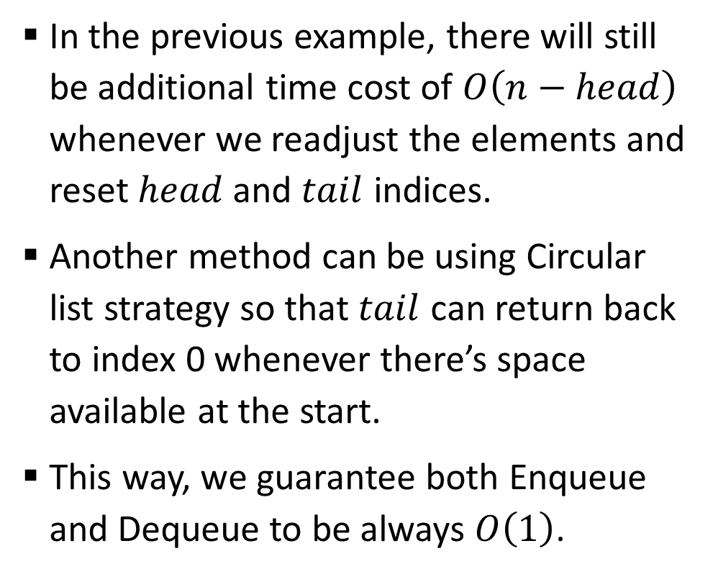
Sample 2
Array Implementation
In the previous example, there will still be additional time cost of $O\left(n−head\right)$ whenever we readjust the elements and reset $head$ and $tail$ indices.
Another method can be using Circular list strategy so that $tail$ can return back to index 0 whenever there’s space available at the start.
This way, we guarantee both Enqueue and Dequeue to be always $O\left(1\right)$.
Head
Hafs
0
Asra
1
Mohimin
2
Shahzaman
3
Omar Baig
4
Tail

Slide 13
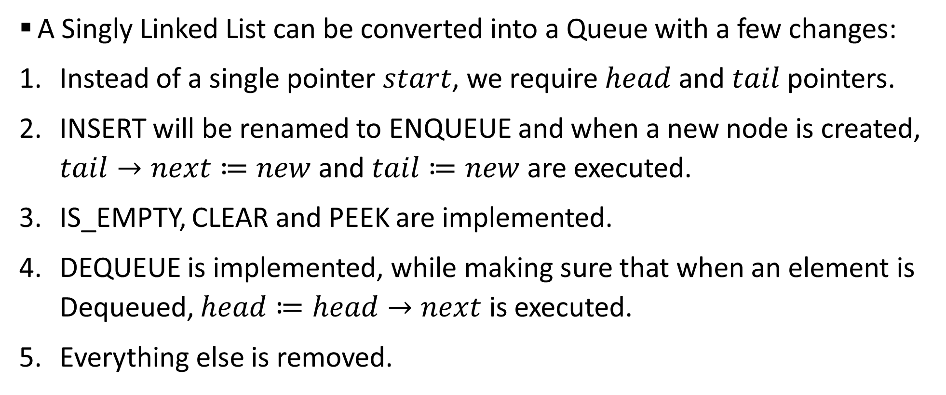
Sample 2
Linked List Implementation
A Singly Linked List can be converted into a Queue with a few changes:
Instead of a single pointer $start$, we require $head$ and $tail$ pointers.
INSERT will be renamed to ENQUEUE and when a new node is created, $tail→next≔new$ and $tail≔new$ are executed.
IS_EMPTY, CLEAR and PEEK are implemented.
DEQUEUE is implemented, while making sure that when an element is Dequeued, $head≔head→next$ is executed.
Everything else is removed.

Slide 14
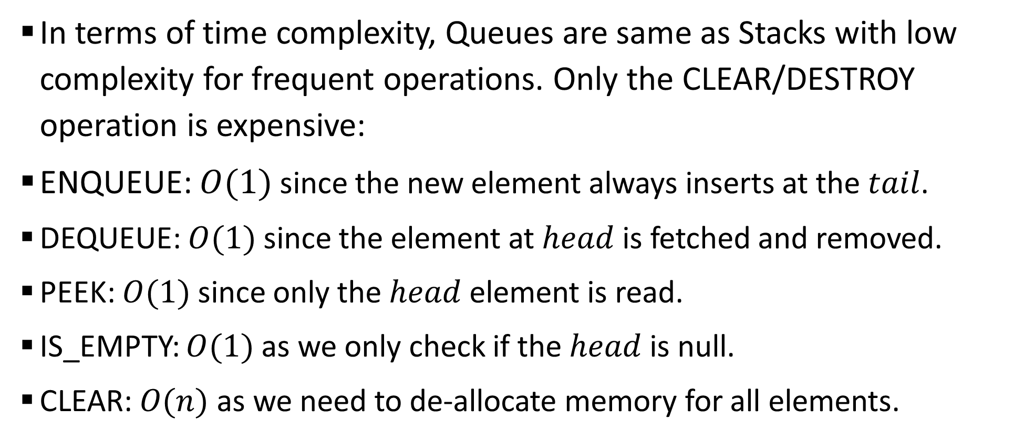
Sample 2
Complexity Analysis
In terms of time complexity, Queues are same as Stacks with low complexity for frequent operations. Only the CLEAR/DESTROY operation is expensive:
ENQUEUE: $O(1)$ since the new element always inserts at the $tail$.
DEQUEUE: $O(1)$ since the element at $head$ is fetched and removed.
PEEK: $O(1)$ since only the $head$ element is read.
IS_EMPTY: $O(1)$ as we only check if the $head$ is null.
CLEAR: $O(n)$ as we need to de-allocate memory for all elements.

Slide 15
Sample 2
In real life
Check out counters at Super marts where customers form a queue.
There are more than one check out counters, but for each counter the customers form a queue to pay for their grocery.
The payment and packaging are done sequentially for each customer irrespective of the items in their trolley.
Every new customer joins the queue from the rear.
The customer at the front is served.

Slide 16
Sample 2
In real life
Task Scheduling: task scheduling algorithms, such as in operating systems. Processes waiting to be executed are enqueued, and the scheduler selects and runs them in the order they were added (FIFO).
Social Media Timeline: platforms display posts in a chronological order, creating a queue of posts from people you follow. The latest post is shown first.
Breadth-First Search (BFS) : a graph traversal algorithm, which uses a queue to visit nodes level by level. It explores all the neighbors of a node before moving on to their neighbors, ensuring that all nodes at the same level are processed before proceeding to the next level. We will implement this later in the course.

Slide 17



THANK YOU
Owais Hussain
+92 345-3174270
owais.hussain@kiet.edu.pk
https://www.researchgate.net/profile/Owais-Hussain-3

